Slide 1

A linear mixed model approach to the analysis of a multi-phase barley malt proteomics experiment Clayton Forknall, Ari Verbyla, Yoni Nazarathy, Adel Yousif, Sarah Osama, Shirley Jones, Edward Kerr, Benjamin L. Schulz, Glen Fox, Alison Kelly Australasian Applied Statistics Conference 2022

Slide 2

Malt is barley grain that has undergone a controlled and limited germination process, before being kilned (baked)
Malting makes complex carbohydrates and sugars in the barley grain more accessible for use in the fermentation process
Additionally, important enzymes that contribute to the brewing process are synthesised and/or released
Malt also adds characteristic colours and flavours to beer
Notes:
I thought I’d start this presentation with a topical quote, especially given we’re in Victoria and my presentation is somewhat related to beer – that quote is from recently re-elected Victorian premier Dan Andrews and goes like this…

Slide 3

Malt is barley grain that has undergone a controlled and limited germination process, before being kilned (baked)
Malting makes complex carbohydrates and sugars in the barley grain more accessible for use in the fermentation process
Additionally, important enzymes that contribute to the brewing process are synthesised and/or released
Malt also adds characteristic colours and flavours to beer
Notes:
Get on the beers.
Now what does getting on the beers have to do with my presentation? Well, it would probably make it much more entertaining, but there is a connection to a dataset that I’m investigating as part of my PhD project, where we have the question…

Slide 4





Malt is barley grain that has undergone a controlled and limited germination process, before being kilned (baked)
Malting makes complex carbohydrates and sugars in the barley grain more accessible for use in the fermentation process
Additionally, important enzymes that contribute to the brewing process are synthesised and/or released
Malt also adds characteristic colours and flavours to beer
WHAT’S
IN
?
Clayton Forknall
Notes:
What’s in the beers? Yep, that’s me asking that question…
In particular, we’re interested in what’s in a key component of beer, being barley malt

Slide 5
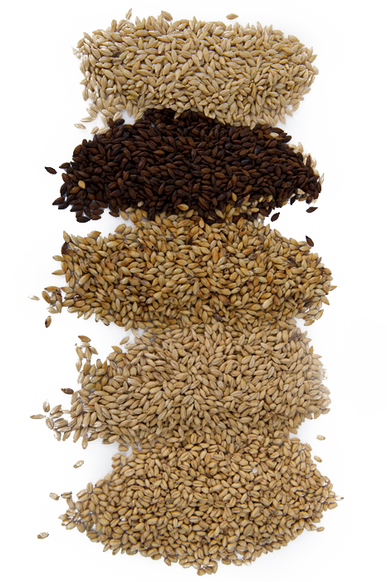
What is barley malt? A key ingredient in beer brewing
Malt is barley grain that has undergone a controlled and limited germination process, before being kilned (baked)
Commercially, in Australia, the malting process takes between approx. 5 to 6 days
Malting makes complex carbohydrates, sugars and proteins in the grain more accessible for use in the fermentation process
A lot is known about the physical and chemical changes that the grain undergoes during the malting process, but not so much about the proteins composing the grain

Slide 6
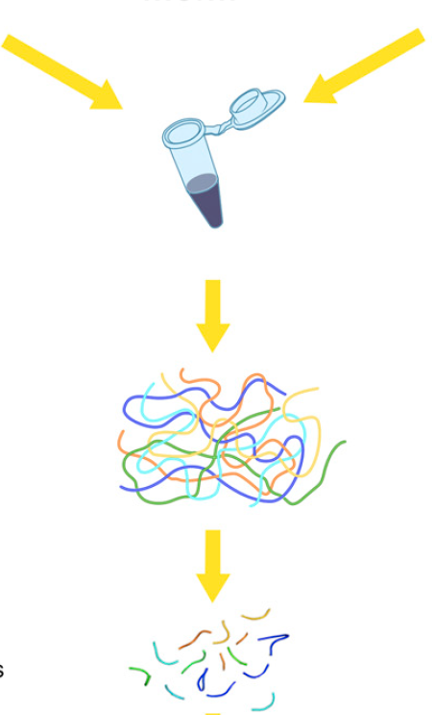
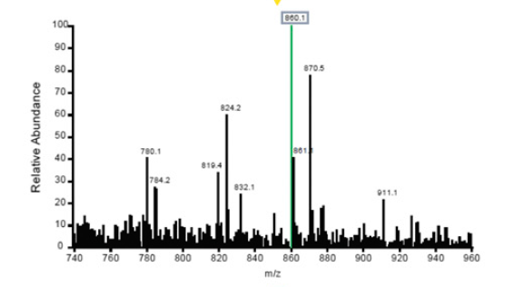
How can we explore changes in protein abundance? Mass spectrometry based proteomics
The proteins composing biological samples can be explored using mass spectrometry based proteomics techniques
These techniques enable both identification and quantification of proteins
Results in large datasets – abundance of upwards of hundreds of proteins quantified from the processing of a single sample

Slide 7





Malt is barley grain that has undergone a controlled and limited germination process, before being kilned (baked)
Malting makes complex carbohydrates and sugars in the barley grain more accessible for use in the fermentation process
Additionally, important enzymes that contribute to the brewing process are synthesised and/or released
Malt also adds characteristic colours and flavours to beer
WHAT’S
IN
?
Clayton Forknall
Notes:
Formalise this question – state aim or a more specific question

Slide 8
Malt is barley grain that has undergone a controlled and limited germination process, before being kilned (baked)
Malting makes complex carbohydrates and sugars in the barley grain more accessible for use in the fermentation process
Additionally, important enzymes that contribute to the brewing process are synthesised and/or released
Malt also adds characteristic colours and flavours to beer
Aim:
How does protein abundance change over time in the malting process?

Slide 9
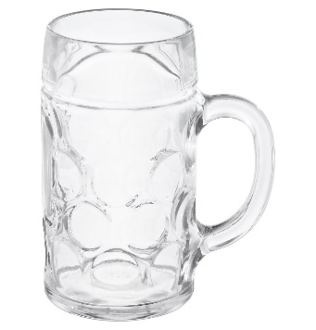
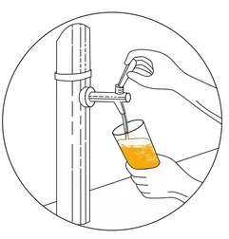
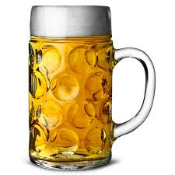
Aim:
How does protein abundance change over time in the malting process?
Malt is barley grain that has undergone a controlled and limited germination process, before being kilned (baked)
Malting makes complex carbohydrates and sugars in the barley grain more accessible for use in the fermentation process
Additionally, important enzymes that contribute to the brewing process are synthesised and/or released
Malt also adds characteristic colours and flavours to beer
Experimental Method
Will that be a pot, schooner or pint?
Analysis Process
Home brewed solutions
Outcomes
A hard earned thirst…

Slide 10
Aim:
How does protein abundance change over time in the malting process?
Malt is barley grain that has undergone a controlled and limited germination process, before being kilned (baked)
Malting makes complex carbohydrates and sugars in the barley grain more accessible for use in the fermentation process
Additionally, important enzymes that contribute to the brewing process are synthesised and/or released
Malt also adds characteristic colours and flavours to beer
Experimental Method
Will that be a pot, schooner or pint?
Analysis Process
Home brewed solutions
Outcomes
A hard earned thirst…

Slide 11
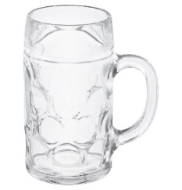
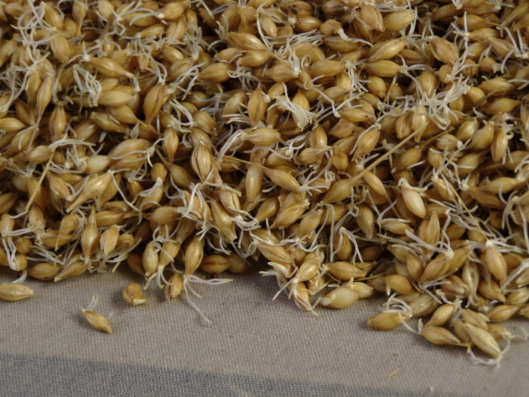
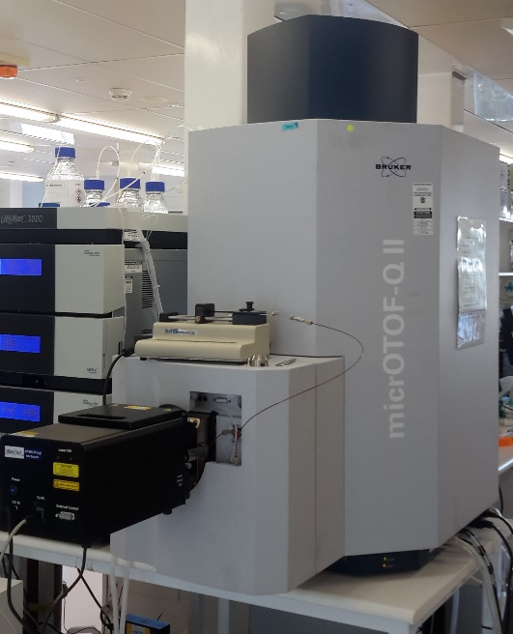
Experimental Method Barley malt time course experiment
Multi-phase experiment
Phase 1: Malt sample collection
Phase 2: Mass spectrometry processing
Multi-phase design implemented (two phases)
Definition: A design applied to a multi-phase experiment, where a multi-phase experiment is such that a valid experiment was conducted in phase one, followed by the randomisation of experimental units from phase one to units in the second phase of the experiment (Brien & Bailey, 2006)

Slide 12

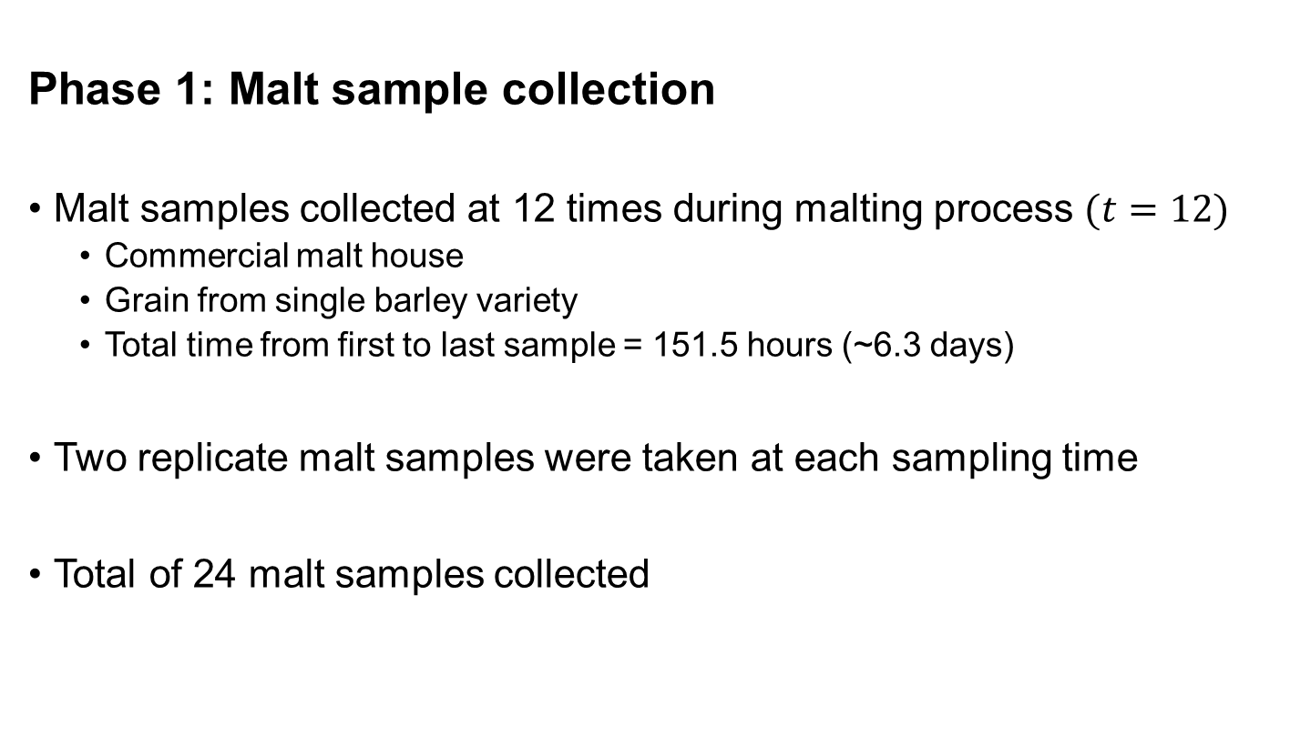
Experimental Method Phase 1: Malt sample collection
Phase 1: Malt sample collection
Malt samples collected at 12 times during malting process $(t=12)$
Commercial malt house
Grain from single barley variety
Total time from first to last sample = 151.5 hours (~6.3 days)
Two replicate malt samples were taken at each sampling time
Total of 24 malt samples collected

Slide 13
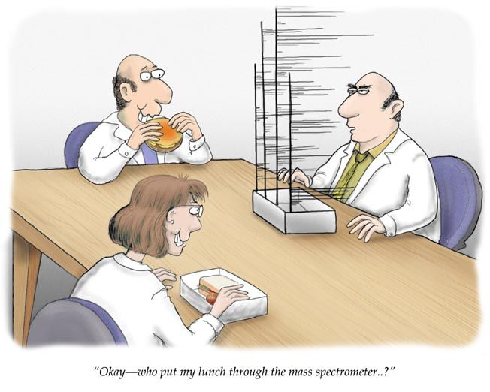
Experimental Method Phase 2: Mass spectrometry processing
Phase 2: Mass spectrometry processing
Duplicate sub-samples taken from each malt sample for processing using mass spectrometry
Mass spectrometry process is destructive
Sub-samples need to be processed one at a time
Structured design applied to the order in which sub-samples were processed
Two replicate blocks – 24 sub-samples processed within each replicate block
Four batches within each replicate block – incomplete block design used to allocate sub-samples to batches
Sub-samples randomised within each batch
At no point was a potential source of variation from Phase 1 confounded with a potential source of variation from Phase 2

Slide 14
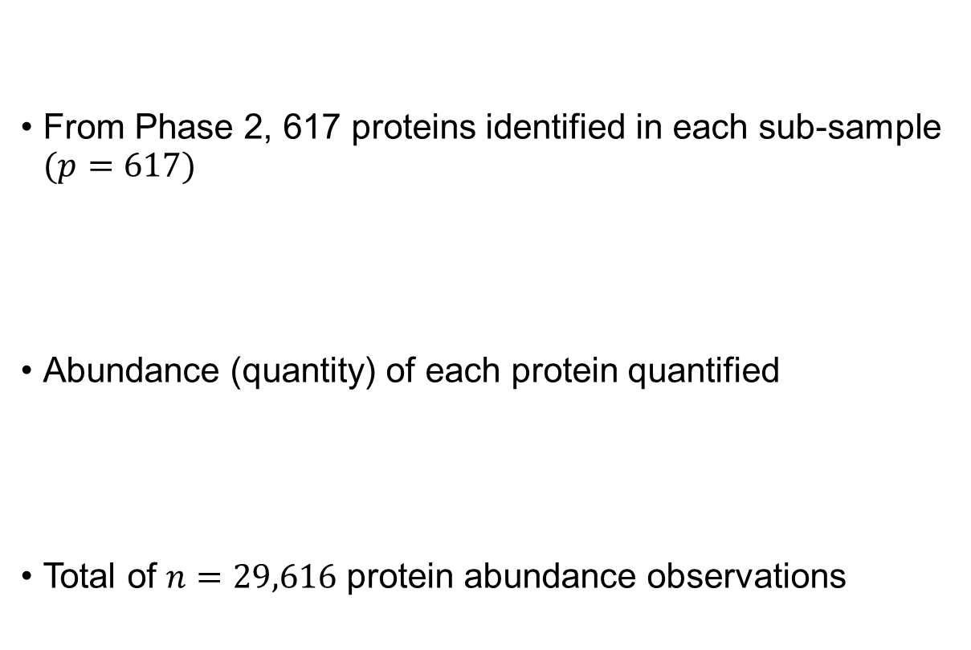
Experimental Method Protein abundance data
From Phase 2, 617 proteins identified in each sub-sample $(p=617)$
Abundance (quantity) of each protein quantified
Total of $n=29,616$ protein abundance observations

Slide 15
Aim:
How does protein abundance change over time in the malting process?
Malt is barley grain that has undergone a controlled and limited germination process, before being kilned (baked)
Malting makes complex carbohydrates and sugars in the barley grain more accessible for use in the fermentation process
Additionally, important enzymes that contribute to the brewing process are synthesised and/or released
Malt also adds characteristic colours and flavours to beer
Experimental Method
Will that be a pot, schooner or pint?
Analysis Process
Home brewed solutions
Outcomes
A hard earned thirst…

Slide 16
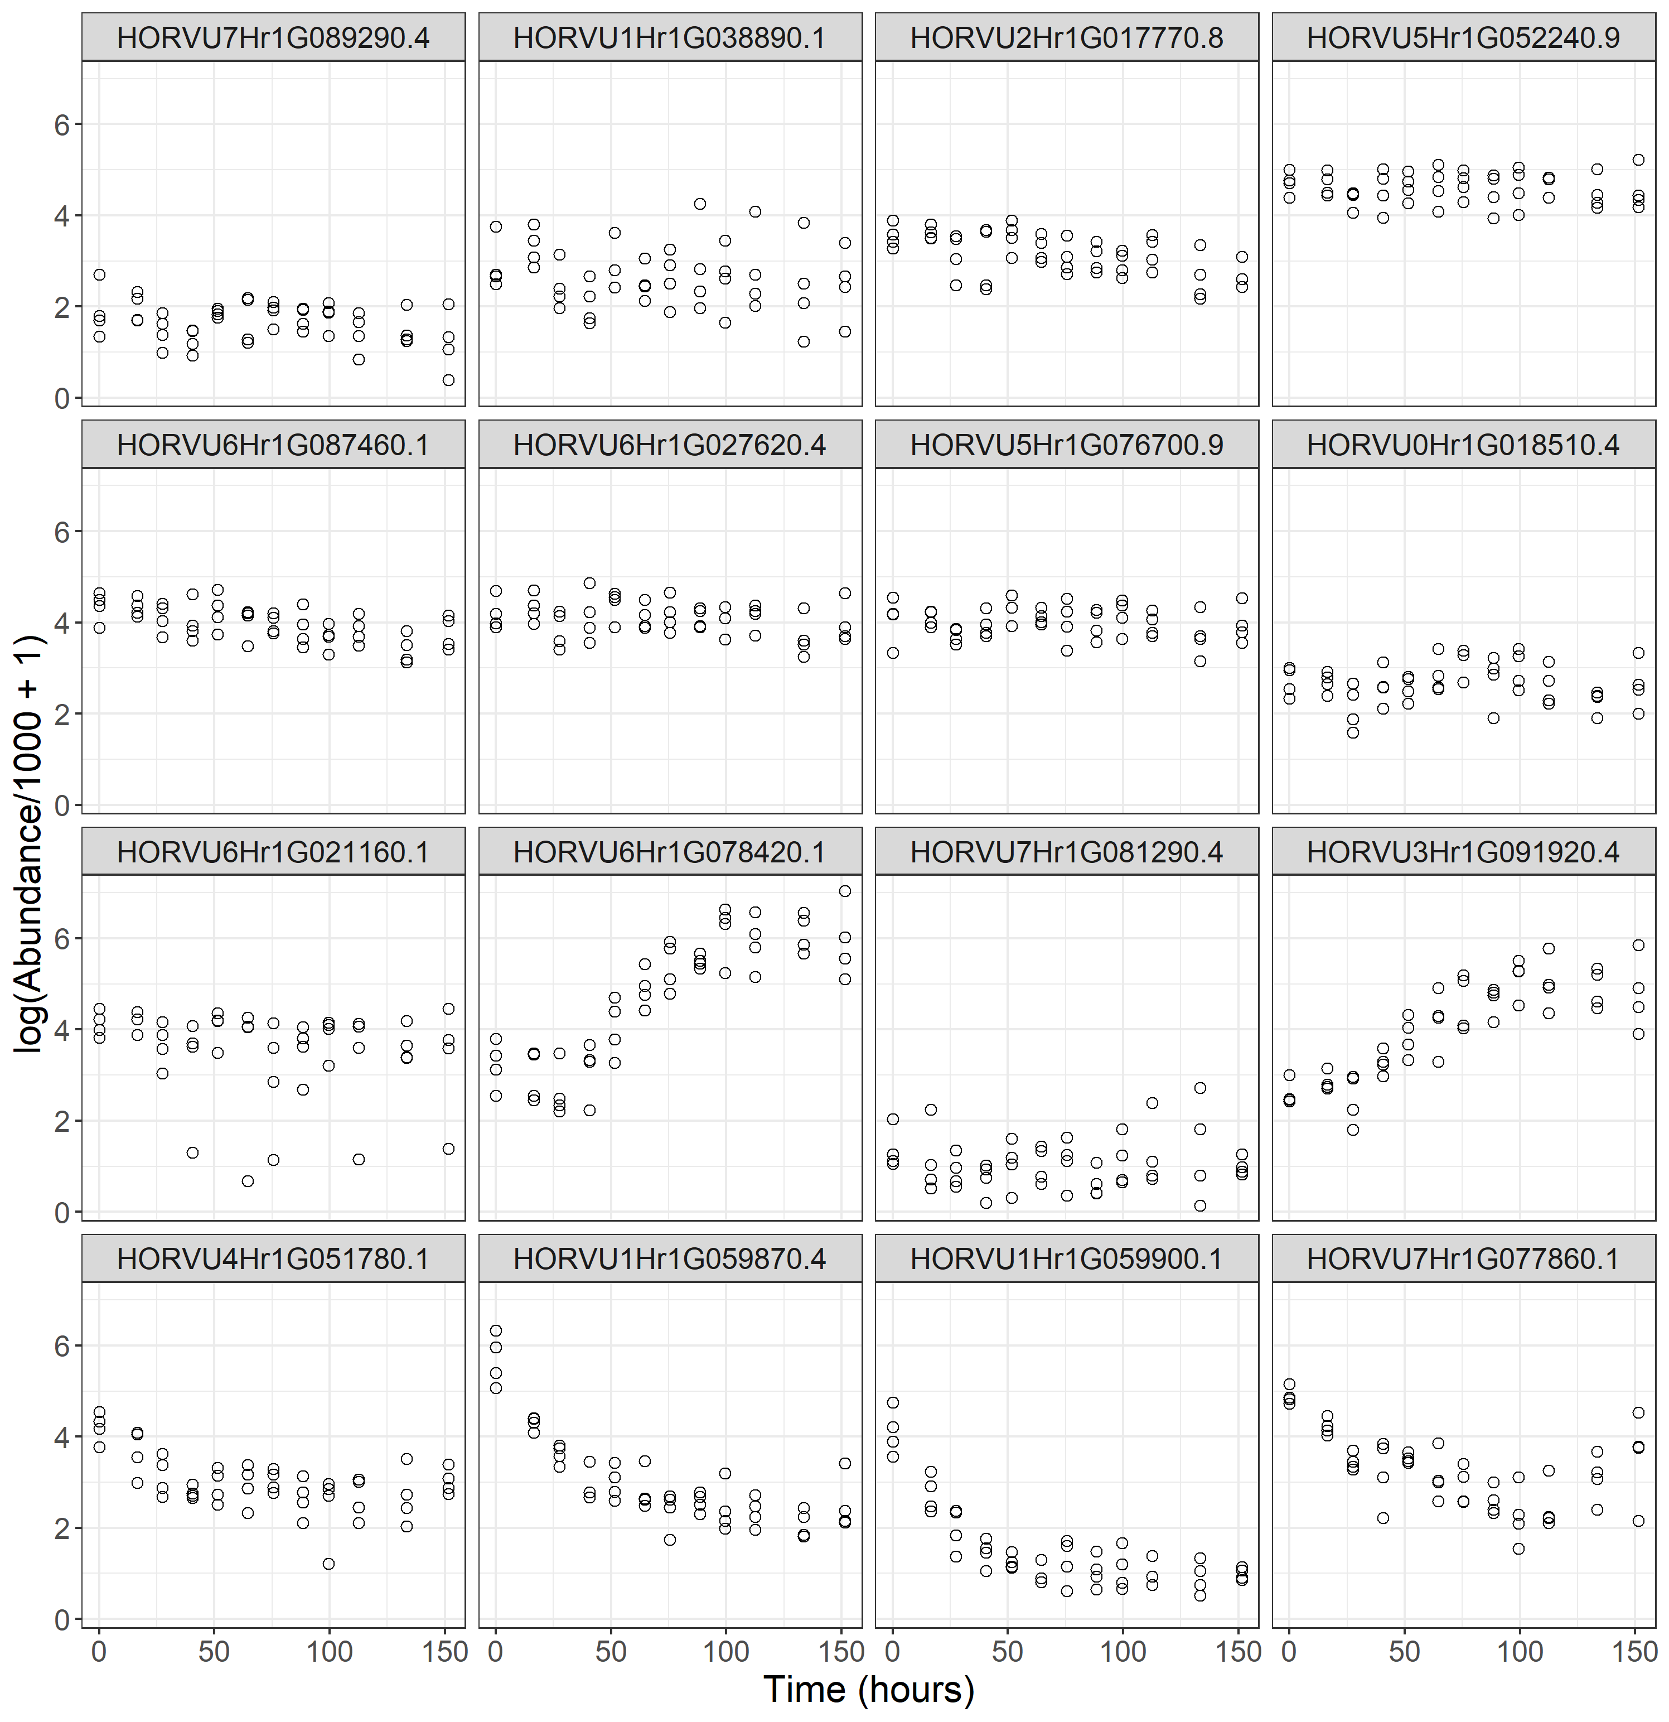
Analysis Process Linear mixed model framework for analysis of protein abundance
Clear non-linear trends apparent for the response of some proteins to time in the malting process
Protein abundance analysed using a two-stage linear mixed model framework
Two-stage approach used due to:
Data set size
Complexity of relationships desired to be modelled
Computational difficulties/run time
All models fit using asreml-R v4 (Butler et al., 2018)

Slide 17
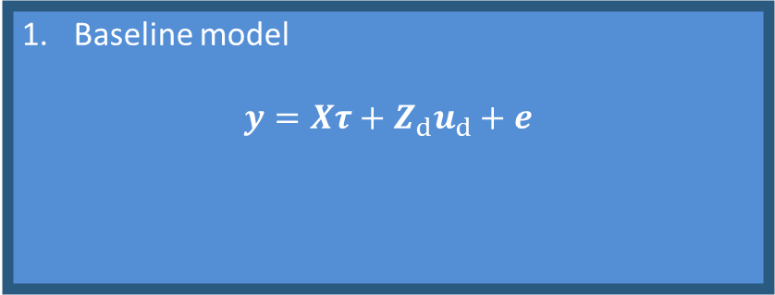
Analysis Process Flowchart – Step 1
Baseline model
$$y=Xτ+Z_{d}u_{d}+e$$

Slide 18
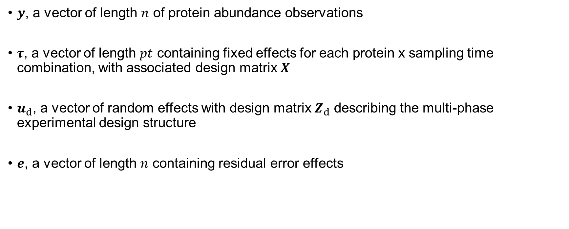
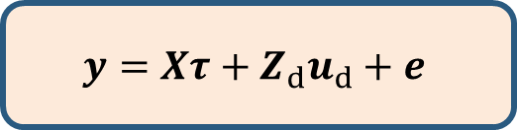
Analysis Process 1. Baseline model – Model description
$$y=Xτ+Z_{d}u_{d}+e$$
$y$, a vector of length $n$ of protein abundance observations
$τ$, a vector of length $pt$ containing fixed effects for each protein x sampling time combination, with associated design matrix $X$
$u_{d}$, a vector of random effects with design matrix $Z_{d}$ describing the multi-phase experimental design structure
$e$, a vector of length $n$ containing residual error effects

Slide 19
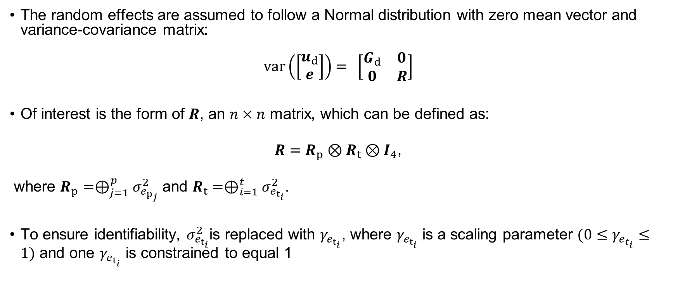
Analysis Process 1. Baseline model – Distribution of random effects
$$y=Xτ+Z_{d}u_{d}+e$$
The random effects are assumed to follow a Normal distribution with zero mean vector and variance-covariance matrix:
$$var\left(\left[\begin{matrix}u_{d} \\ e\end{matrix}\right]\right)=\begin{matrix}\end{matrix}\left[\begin{matrix}G_{d} & 0 \\ 0 & R\end{matrix}\right]$$
Of interest is the form of $R$, an $n×n$ matrix, which can be defined as:
$R=R_{p}⊗R_{t}⊗I_{4}$,
where $R_{p}=⊕_{j=1}^{p}σ_{e_{p_{j}}}^{2}$ and $R_{t}=⊕_{i=1}^{t}σ_{e_{t_{i}}}^{2}$.
To ensure identifiability, $σ_{e_{t_{i}}}^{2}$is replaced with $γ_{e_{t_{i}}}$, where $γ_{e_{t_{i}}}$ is a scaling parameter $(0≤γ_{e_{t_{i}}}≤1)$ and one $γ_{e_{t_{i}}}$ is constrained to equal 1

Slide 20
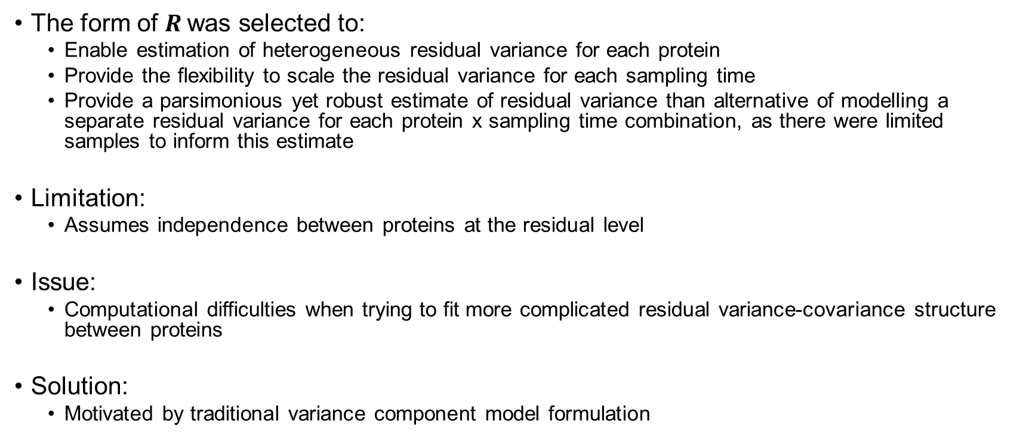
Analysis Process 1. Baseline model – Residual model
$$y=Xτ+Z_{d}u_{d}+e$$
The form of $R$was selected to:
Enable estimation of heterogeneous residual variance for each protein
Provide the flexibility to scale the residual variance for each sampling time
Provide a parsimonious yet robust estimate of residual variance than alternative of modelling a separate residual variance for each protein x sampling time combination, as there were limited samples to inform this estimate
Limitation:
Assumes independence between proteins at the residual level
Issue:
Computational difficulties when trying to fit more complicated residual variance-covariance structure between proteins
Solution:
Motivated by traditional variance component model formulation

Slide 21
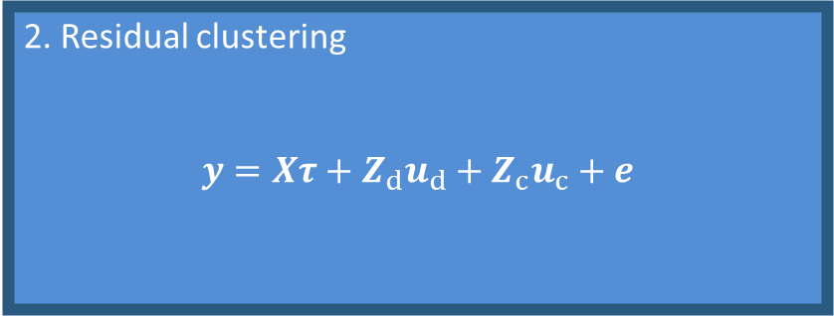

Analysis Process Flowchart – Step 2
Baseline model
$$y=Xτ+Z_{d}u_{d}+e$$
Residuals $(e)$
2. Residual clustering
$$y=Xτ+Z_{d}u_{d}+Z_{c}u_{c}+e$$

Slide 22
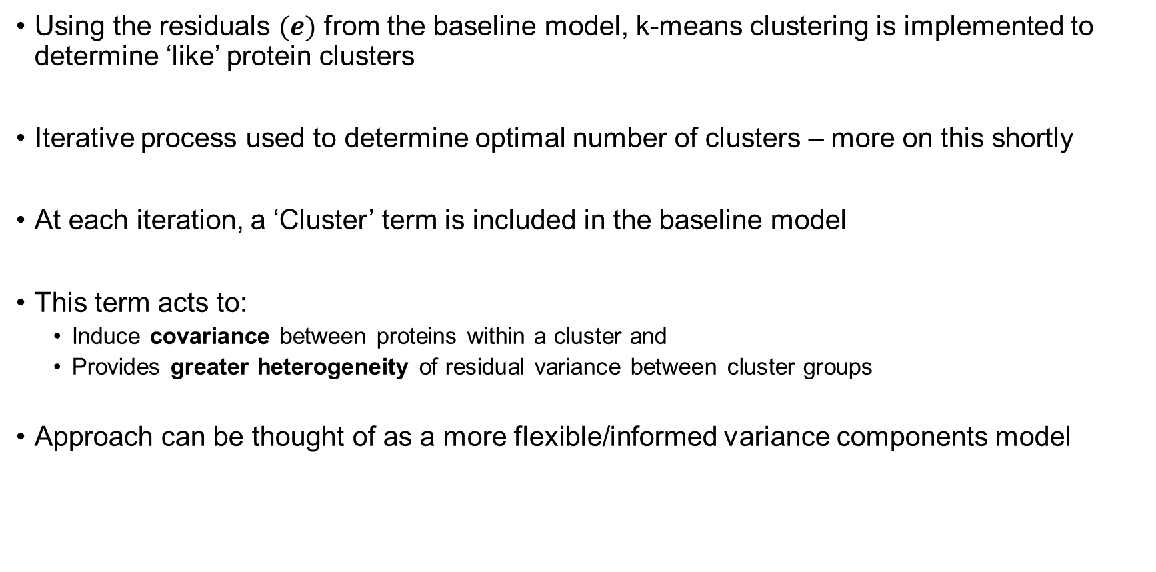
Analysis Process 2. Residual clustering – How does it work?
Using the residuals $(e)$ from the baseline model, k-means clustering is implemented to determine ‘like’ protein clusters
Iterative process used to determine optimal number of clusters – more on this shortly
At each iteration, a ‘Cluster’ term is included in the baseline model
This term acts to:
Induce covariance between proteins within a cluster and
Provides greater heterogeneity of residual variance between cluster groups
Approach can be thought of as a more flexible/informed variance components model

Slide 23
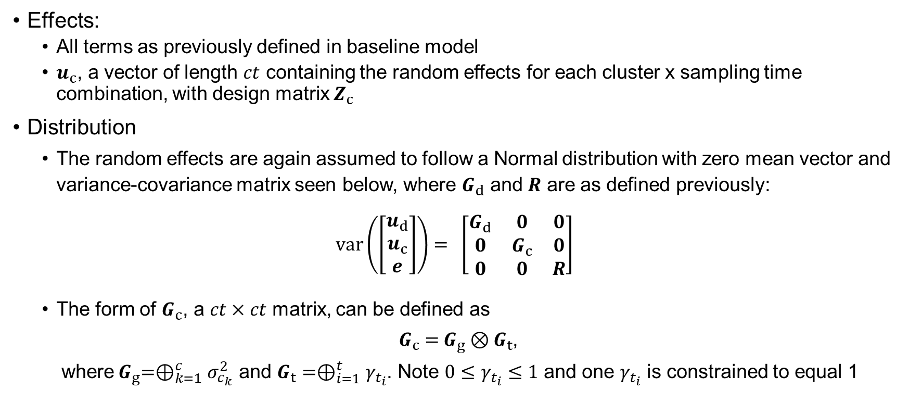
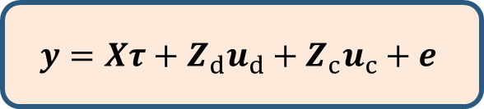
Analysis Process 2. Residual clustering – Model description
$$y=Xτ+Z_{d}u_{d}+Z_{c}u_{c}+e$$
Effects:
All terms as previously defined in baseline model
$u_{c}$, a vector of length $ct$ containing the random effects for each cluster x sampling time combination, with design matrix $Z_{c}$
Distribution
The random effects are again assumed to follow a Normal distribution with zero mean vector and variance-covariance matrix seen below, where $G_{d}$ and $R$ are as defined previously:
$$var\left(\left[\begin{matrix}u_{d} \\ u_{c} \\ e\end{matrix}\right]\right)=\begin{matrix}\end{matrix}\left[\begin{matrix}G_{d} & 0 & 0 \\ 0 & G_{c} & 0 \\ 0 & 0 & R\end{matrix}\right]$$
The form of $G_{c}$, a $ct×ct$ matrix, can be defined as
${ G}_{c} ={ G}_{g} ⊗G_{t}$,
where${ G}_{g}=⊕_{k=1}^{c}σ_{c_{k}}^{2}$ and $G_{t}=⊕_{i=1}^{t}γ_{t_{i}}$. Note $0≤γ_{t_{i}}≤1$ and one $γ_{t_{i}}$ is constrained to equal 1

Slide 24
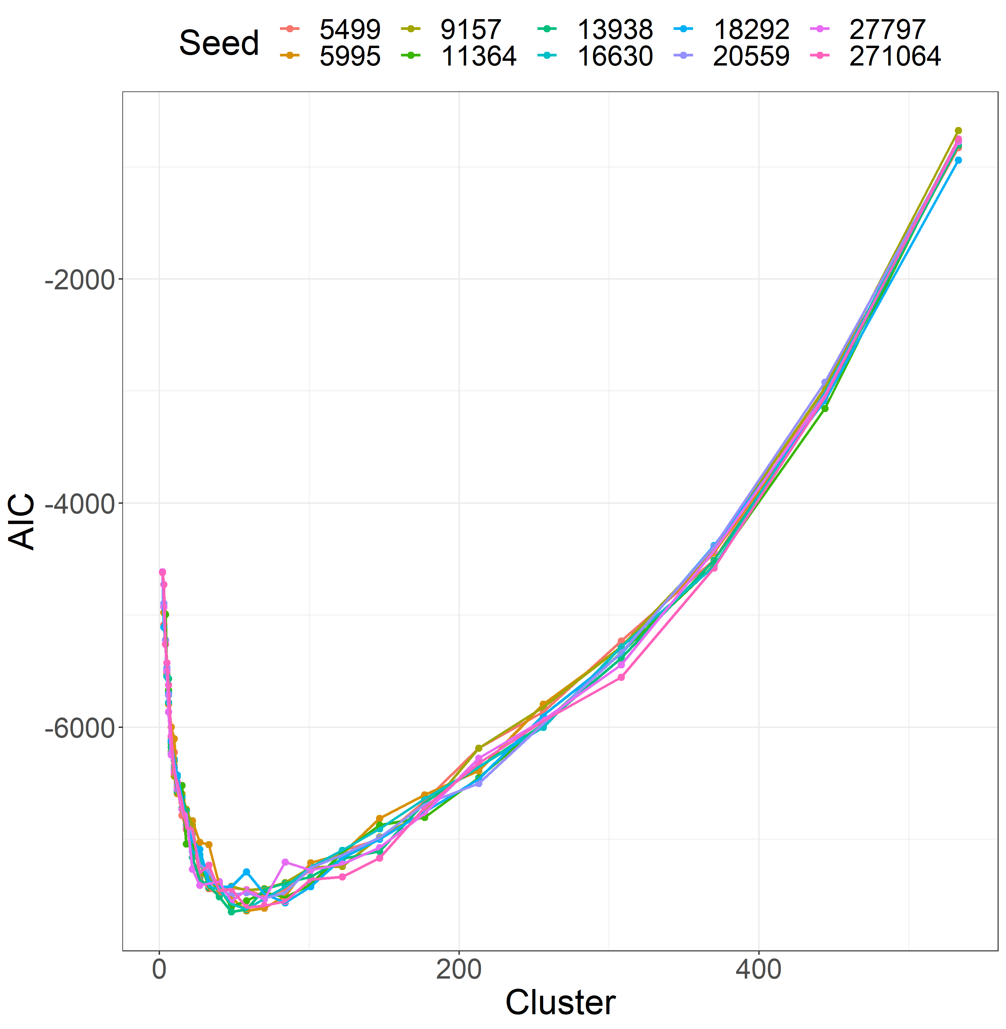
Analysis Process 2. Residual clustering – Iterative cluster procedure
Trialled a geometric progression of clusters, refitting the model each time
Due to randomness of k-means clustering procedure, trialled 10 different seeds to provide sample path of model fit
Optimal number of clusters determined as that with the minimum average AIC across all samples

Slide 25
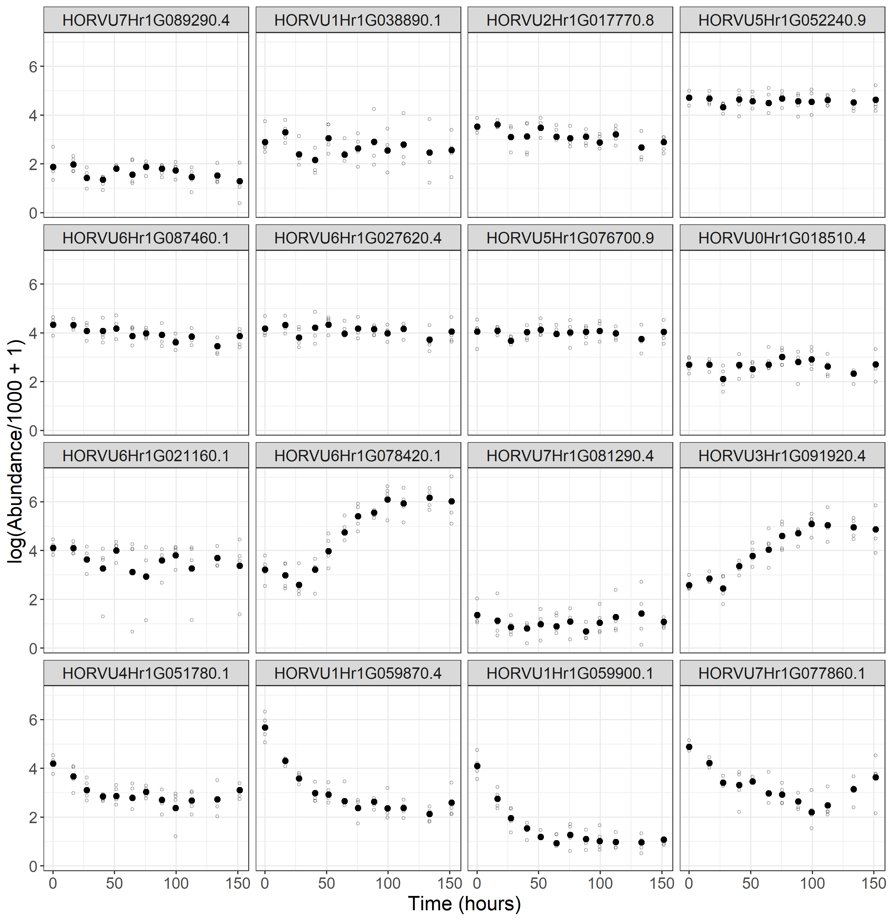
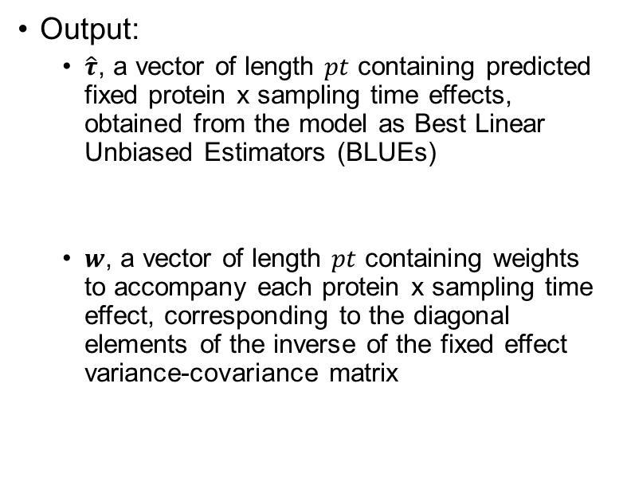

Analysis Process 2. Residual clustering – Output
$$y=Xτ+Z_{d}u_{d}+Z_{c}u_{c}+e$$
Output:
$\hat{τ}$, a vector of length $pt$ containing predicted fixed protein x sampling time effects, obtained from the model as Best Linear Unbiased Estimators (BLUEs)
$w$, a vector of length $pt$ containing weights to accompany each protein x sampling time effect, corresponding to the diagonal elements of the inverse of the fixed effect variance-covariance matrix

Slide 26
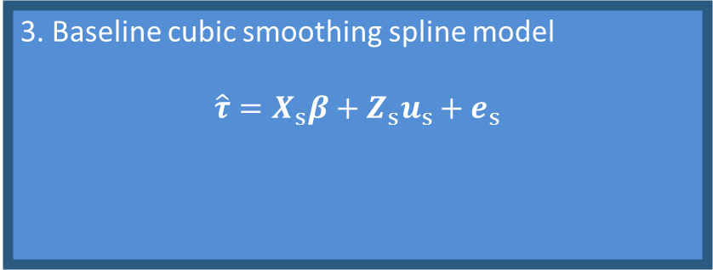

Analysis Process Flowchart – Step 3
Baseline model
$$y=Xτ+Z_{d}u_{d}+e$$
3. Baseline cubic smoothing spline model
$$\hat{τ}=X_{s}β+Z_{s}u_{s}+e_{s}$$
Predictions $(\hat{τ})$ & weights $(w)$
Residuals $(e)$
2. Residual clustering
$$y=Xτ+Z_{d}u_{d}+Z_{c}u_{c}+e$$

Slide 27
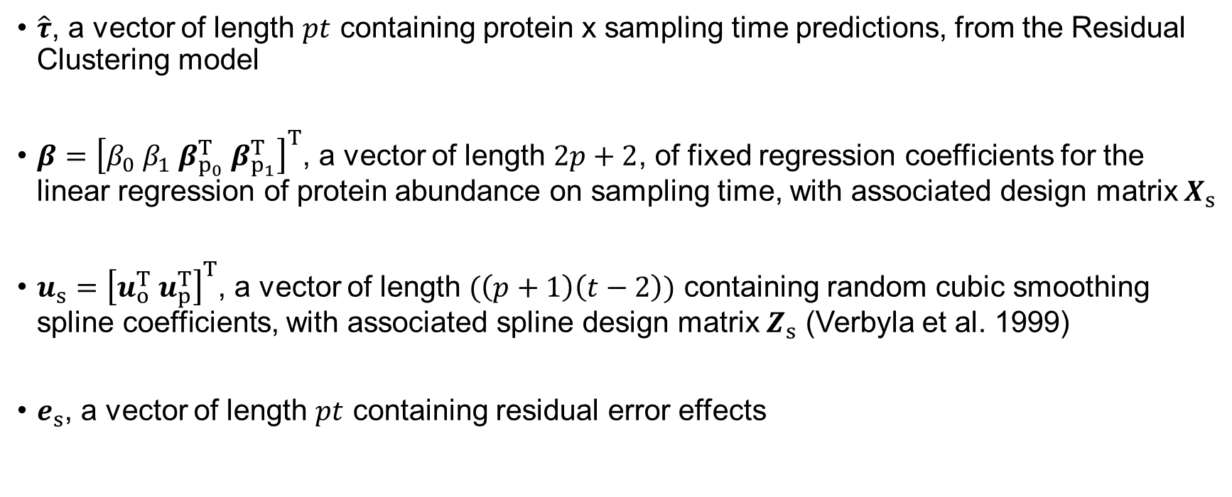
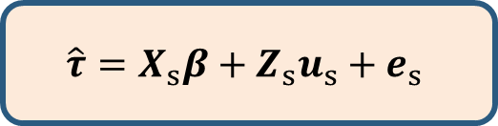
Analysis Process 3. Baseline cubic smoothing spline model – Model description
$$\hat{τ}=X_{s}β+Z_{s}u_{s}+e_{s}$$
$\hat{τ}$, a vector of length $pt$ containing protein x sampling time predictions, from the Residual Clustering model
$β={\left[β_{0} β_{1} β_{p_{0}}^{T} β_{p_{1}}^{T}\right]}^{T}$, a vector of length $2p+2$, of fixed regression coefficients for the linear regression of protein abundance on sampling time, with associated design matrix $X_{s}$
$u_{s}={\left[u_{o}^{T} u_{p}^{T}\right]}^{T}$, a vector of length $(\left(p+1\right)\left(t−2\right))$ containing random cubic smoothing spline coefficients, with associated spline design matrix $Z_{s}$ (Verbyla et al. 1999)
$e_{s}$, a vector of length $pt$ containing residual error effects

Slide 28
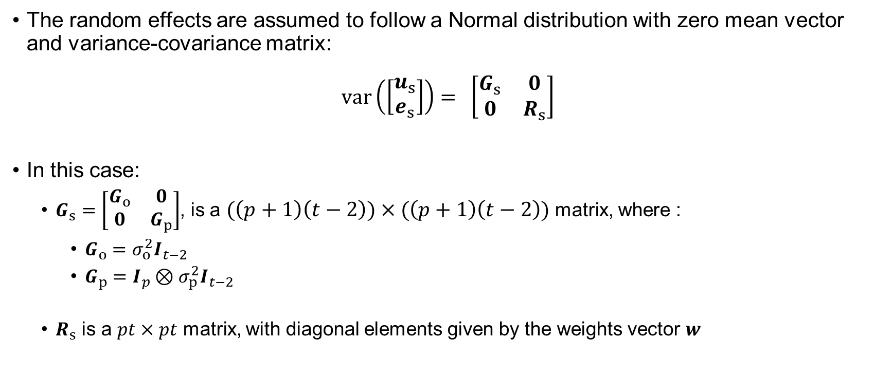
Analysis Process 3. Baseline cubic smoothing spline model – Distribution of random effects
$$\hat{τ}=X_{s}β+Z_{s}u_{s}+e_{s}$$
The random effects are assumed to follow a Normal distribution with zero mean vector and variance-covariance matrix:
$$var\left(\left[\begin{matrix}u_{s} \\ e_{s}\end{matrix}\right]\right)=\begin{matrix}\end{matrix}\left[\begin{matrix}G_{s} & 0 \\ 0 & R_{s}\end{matrix}\right]$$
In this case:
$G_{s}=\left[\begin{matrix}G_{o} & 0 \\ 0 & G_{p}\end{matrix}\right]$, is a $(\left(p+1\right)\left(t−2\right))×(\left(p+1\right)\left(t−2\right))$ matrix, where :
$G_{o}=σ_{o}^{2}I_{t−2}$
$G_{p}=I_{p}⊗σ_{p}^{2}I_{t−2}$
$R_{s}$ is a $pt×pt$ matrix, with diagonal elements given by the weights vector $w$

Slide 29
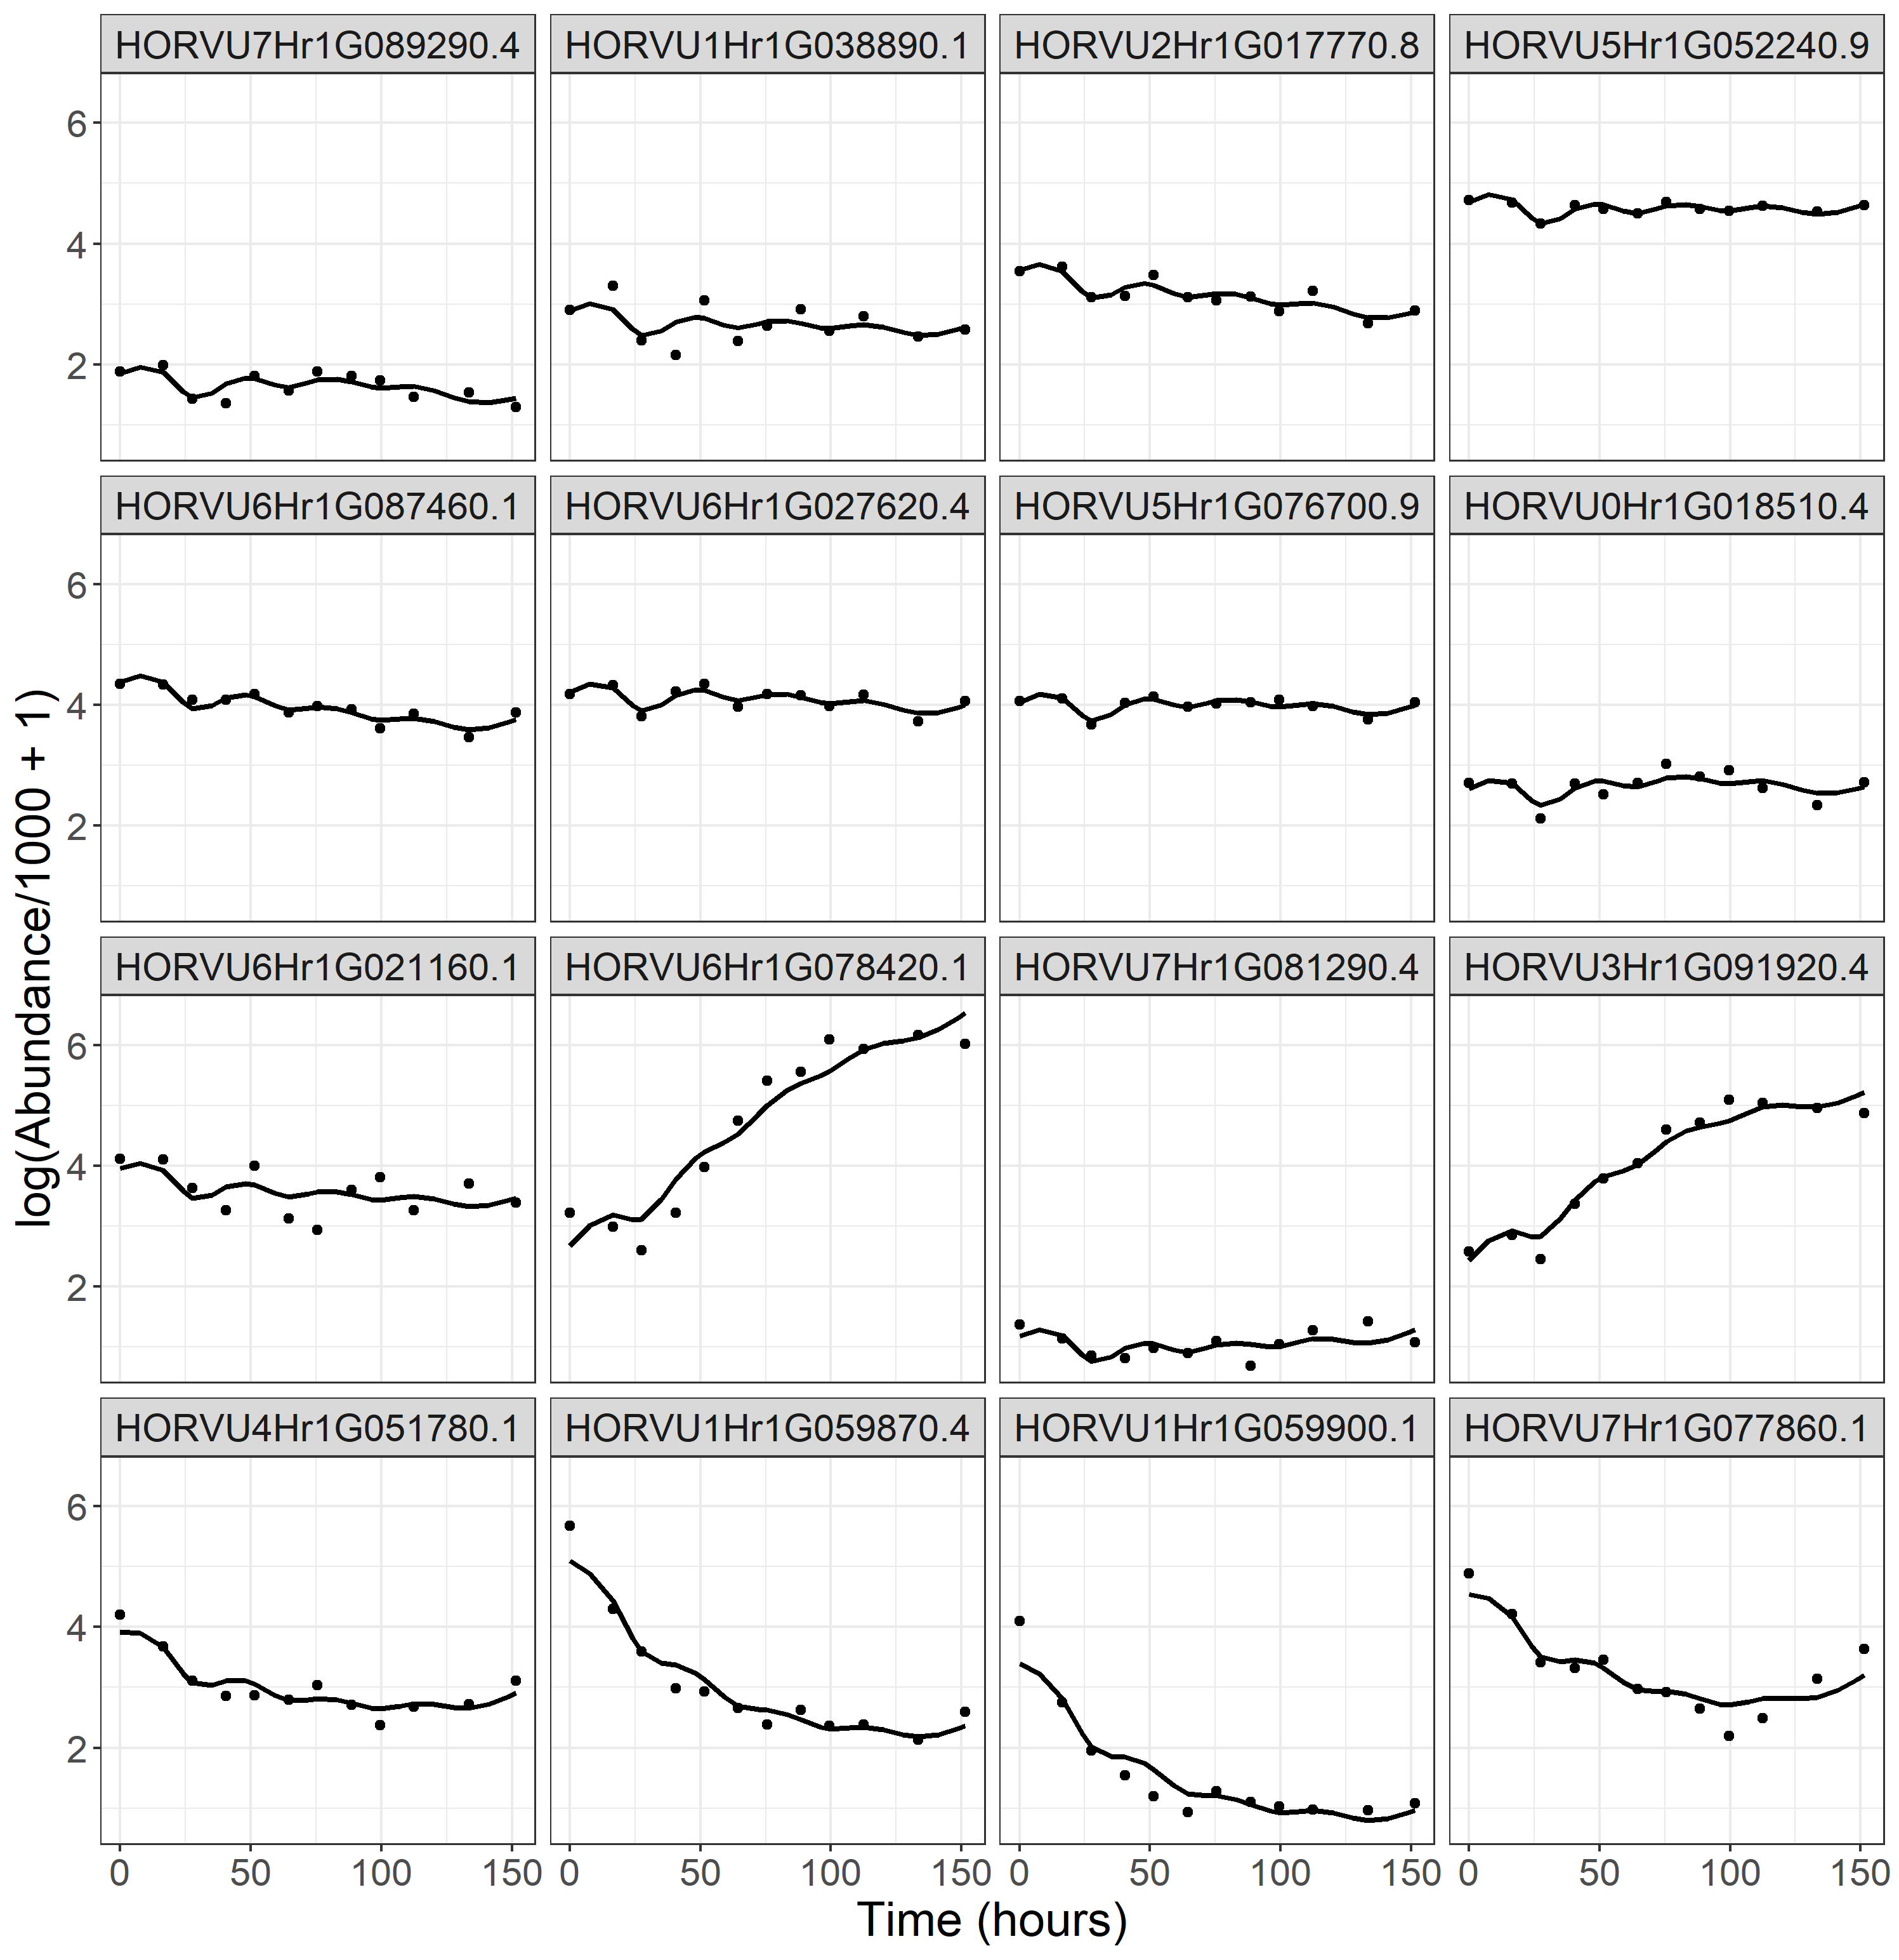
Analysis Process 3. Baseline cubic smoothing spline model – Output
Estimated response curves describing protein response to time in the malting process
Significant variation in protein responses to time in the malting process

Slide 30




Analysis Process Flowchart – Step 4 – Still brewing!
Baseline model
$$y=Xτ+Z_{d}u_{d}+e$$
3. Baseline cubic smoothing spline model
$$\hat{τ}=X_{s}β+Z_{s}u_{s}+e_{s}$$
Predictions $(\hat{τ})$ & weights $(w)$
Residuals $(e)$
2. Residual clustering
$$y=Xτ+Z_{d}u_{d}+Z_{c}u_{c}+e$$
Still brewing

Slide 31
Aim:
How does protein abundance change over time in the malting process?
Malt is barley grain that has undergone a controlled and limited germination process, before being kilned (baked)
Malting makes complex carbohydrates and sugars in the barley grain more accessible for use in the fermentation process
Additionally, important enzymes that contribute to the brewing process are synthesised and/or released
Malt also adds characteristic colours and flavours to beer
Experimental Method
Will that be a pot, schooner or pint?
Analysis Process
Home brewed solutions
Outcomes
A hard earned thirst…

Slide 32


Outcomes
Modelling approach addressed aim
Response to malting time modelled for each protein
Significant variation in the responses of proteins to time in the malting process
Novel insights to the brewing industry
Computationally feasible and parsimonious analysis method provided a means of analysing structured, large data in a linear mixed model framework
Method demonstrated non-negligible variation arising in both phases of experimentation
Important and informative result for mass spectrometry researchers

Slide 33
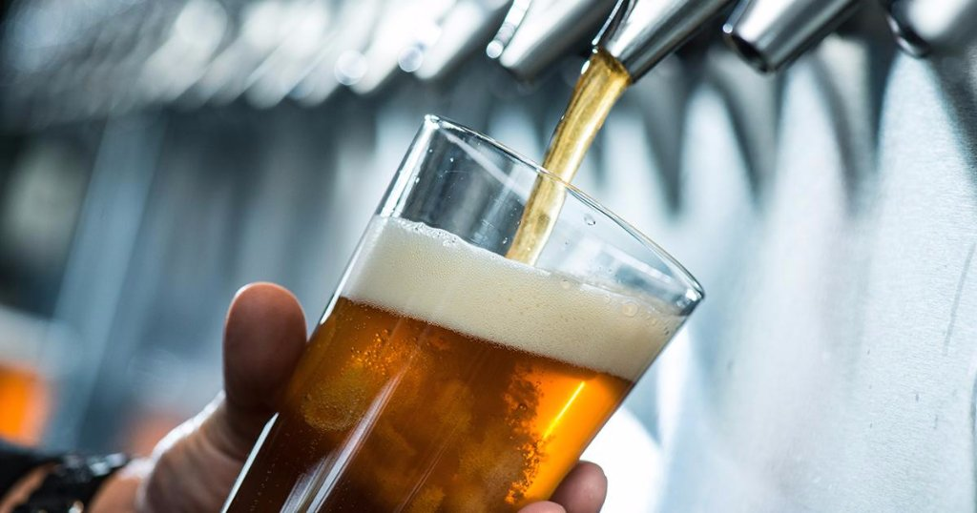
Ongoing Work Keeping up the homebrew solutions
Grouping ‘like’ protein responses
Working on similar clustering approach to group protein responses to malting time
Aim to reduce dimensionality of model outputs and provide researchers with ‘typical’ set of protein responses
Progressing publication
Aim to publish in first half of 2023

Slide 34


Acknowledgements
Supervisors:
Associate Professor Yoni Nazarathy
Dr Alison Kelly
Honorary Professor Ari Verbyla
Institutions
Department of Agriculture and Fisheries
University of Queensland
Grains Research and Development Corporation
Collaborators:
Dr Adel Yousif, University of Tasmania
Professor Benjamin Schulz, University of Queensland
Edward Kerr, University of Queensland
Dr Sarah Osama, University of Queensland
Shirley Jones, University of Southern Queensland
Professor Glen Fox, University of California, Davis
Notes:
Need to shout you all a beer!

Slide 35
Malt is barley grain that has undergone a controlled and limited germination process, before being kilned (baked)
Malting makes complex carbohydrates and sugars in the barley grain more accessible for use in the fermentation process
Additionally, important enzymes that contribute to the brewing process are synthesised and/or released
Malt also adds characteristic colours and flavours to beer
WHAT’S
IN
?
Clayton Forknall
Notes:
To wrap up, in response to the question, what’s in the beers, we’ve implemented a parsimonious, computationally feasible, yet robust statistical analysis approach. Why?

Slide 36
Malt is barley grain that has undergone a controlled and limited germination process, before being kilned (baked)
Malting makes complex carbohydrates and sugars in the barley grain more accessible for use in the fermentation process
Additionally, important enzymes that contribute to the brewing process are synthesised and/or released
Malt also adds characteristic colours and flavours to beer
WHAT’S
IN
?
Clayton Forknall
Notes:
So we can keep “getting on the beers”

